Slide 1

Notes:
Presenter
2014-07-17 14:34:22
--------------------------------------------
Hello, I’m Joe eames. In this module, we’ll be looking at some changes that ecmascript 6 will be bringing to built in objects, which will include existing objects and some new ones. We’ll look at how numbers are different in ES6, and some new functionality on the Math Object, we’ll also see how the Array object is changing, and we’ll also look at some new objects: Sets and Maps, which have both a regular version, and a weak reference version. In order to look at the examples from this module, I’ll be using two different browsers, Chrome, and FireFox Nightly. Now by the time you watch this, all the functionality may be available in the release versions of chrome or FireFox, or by some miracle, Internet Explorer. So even though you’ll easily be able to identify which browser I’m using, check the ES6 compatibility chart, try out the functionality in your favorite browser and if it doesn’t work, then try it in another browser, and if you have to, then use the same browser I’m using.

Slide 2
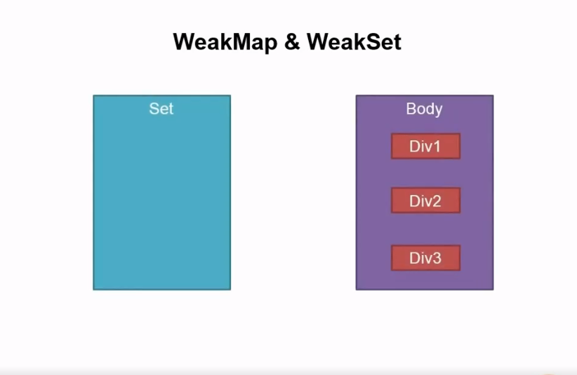

Slide 3
WeakMap & WeakSet
Set
Body
Item1
Div1
Item2
Div2
Item3
Div3
Notes:
Presenter
2014-07-17 14:34:22
--------------------------------------------
Weakmaps!

Slide 4
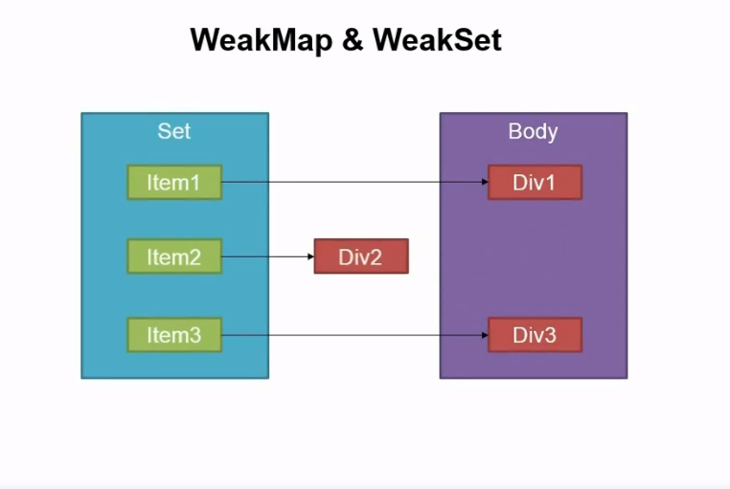

Slide 5
Summary
Number Math
Set Map
arrays
WeakSet WeakMap
Notes:
Presenter
2014-07-17 14:34:22
--------------------------------------------
In this module we looked at some interesting features of ecmascript 6. <B>We saw the new capabilities of numbers and math, <B> how arrays have changed, <B> and we looked at the 2 new data structures in ES6, Set and Map, <B> and also looked at how their weak versions worked as well. All these new features give us a greatly improved capability to solve algorithmic problems in JavaScript

